Slide 1

RFID
Card scanner

Slide 2

RFID
RADIO FREQUENCY IDENTIFICATION

Slide 3
PRESENTATION OUTLINE​
RFID INTRODUCTION​
BLOCK DIAGRAM​
COMPONENTS​
APPLICATIONS​

Slide 4

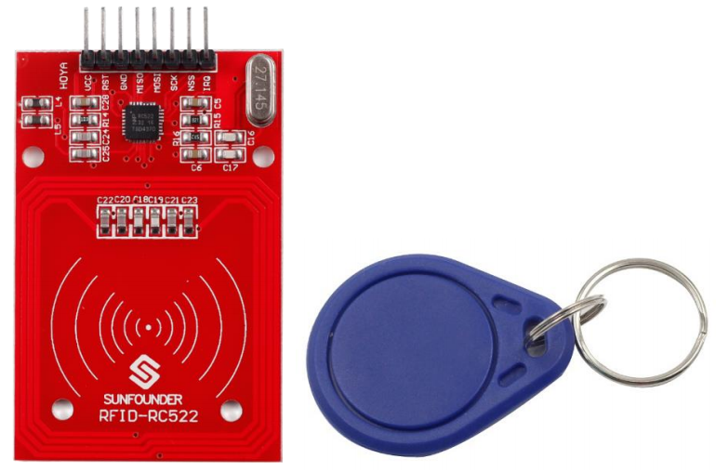
RFID Introduction
Radio-Frequency Identification (RFID) is the use of radio waves to read and capture information stored on a tag attached to an object. A tag can be read from up to several feet away and does not need to be within direct line-of-sight of the reader to be tracked.

Slide 5
BLOCKDIAGRAM
i
Power supply
ESP-32
Board
RFID
Serial Monitor
Input
Output
output
out
buzzer
LED
This Photo by Unknown author is licensed under CC BY-SA

Slide 6
components
BUZZER
ESP-32
RFID CaRD
RFID READER
LED

Slide 7
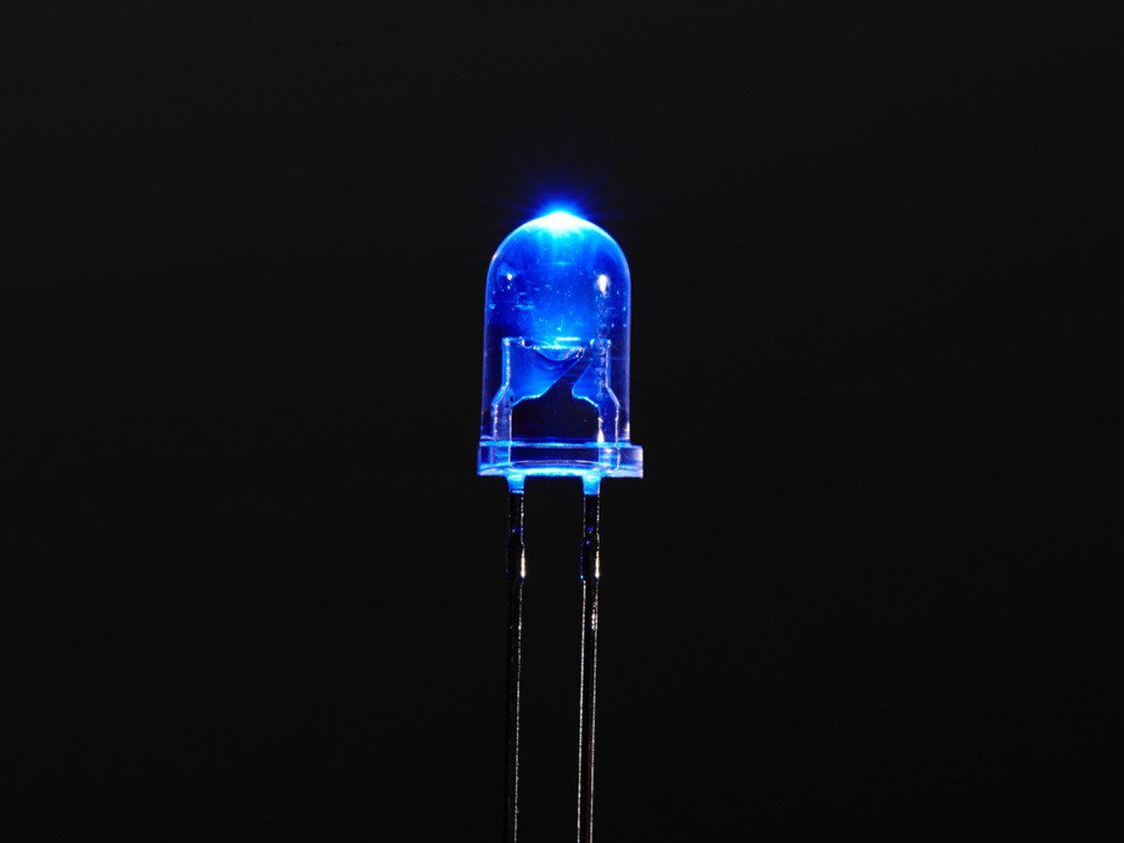
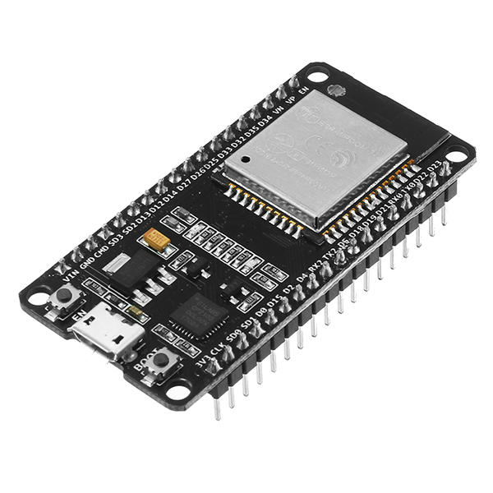
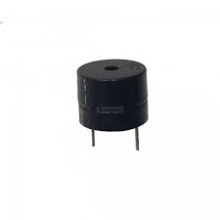
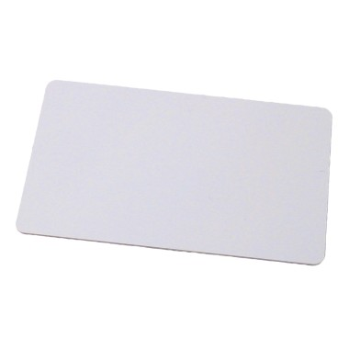
RFID READER​
LED​
BUZZER​
ESP-32
RFID CARD​

Slide 8
Applications of RFID:
The RFID has the applications in the following fields:
In the automatic checkout
In the security control
Race Timing
Transportation

Slide 9
Thank you

Slide 10
Rfid card scanner
Team members
Bhargav
Nagendra
William carie

